Slide 1

Information Retrieval Chapter 2: Foundation of IR TY B.Sc. (CS)
Semester VI
Poornima .N
Assistant Professor, Department of IT/CS
1

Slide 2

2 Topics:
Document Indexing
Storage
Compression
Ever wondered how Google finds results in 0.3 seconds? Let’s find out! 😄

Slide 3
3 What is Document Indexing?
Document indexing is the process of organizing documents to make searching faster and more efficient.
It’s like creating a “catalog” or “table of contents” for all documents in a collection.
Without indexing, a search engine would have to go through every word in every document — which is very slow

Slide 4
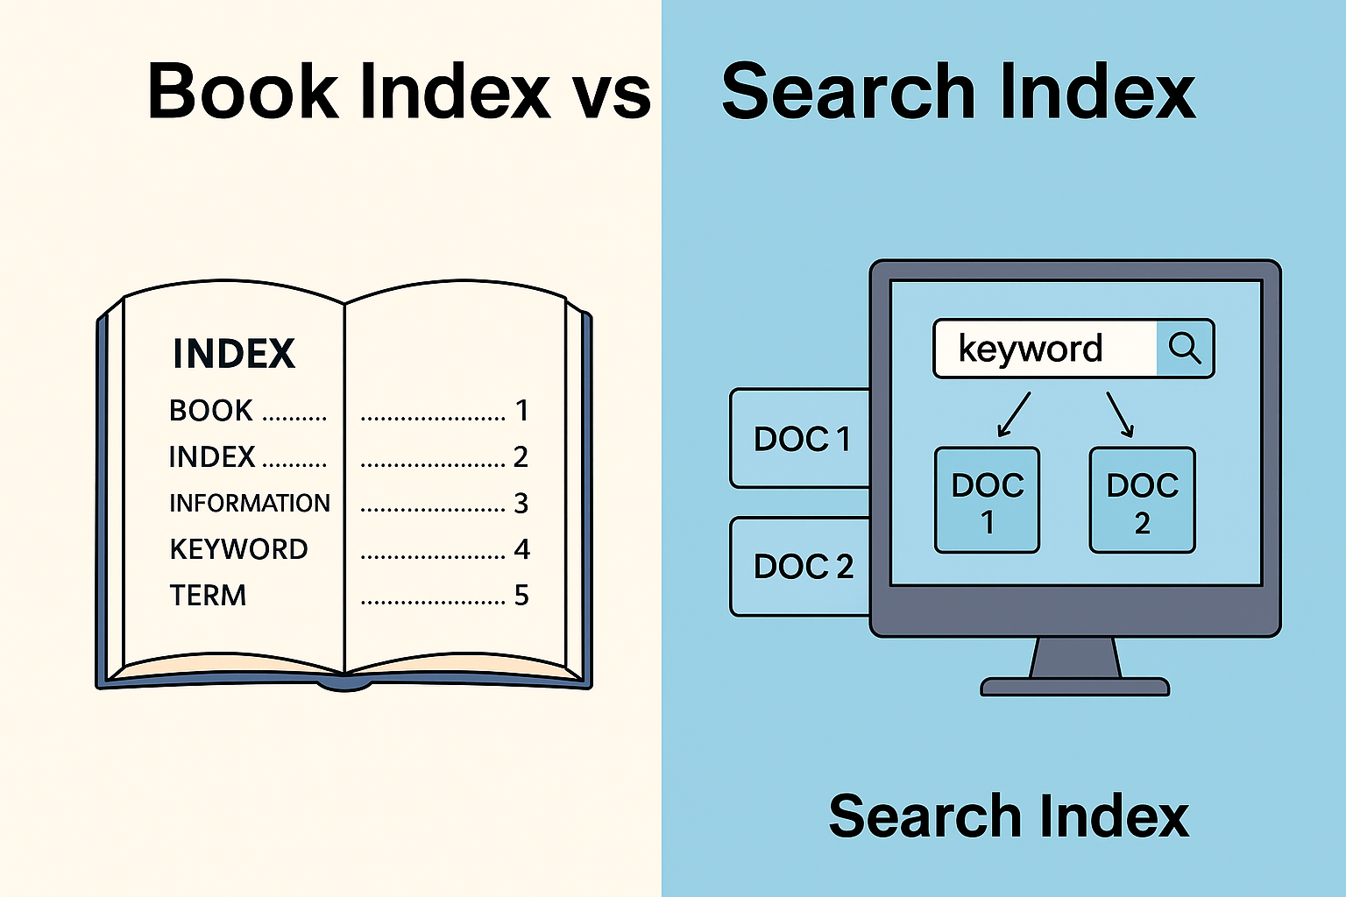
Term | Documents
AI | D1, D3, D5
Machine | D2, D4
Learning | D1, D4, D5

Slide 5
Activity 1
Question 1: “Imagine you have these 3 short documents — can you list the keywords (important terms) that would be stored in the index for each?”
Documents:
Doc1: AI improves education
Doc2: Education empowers society
Doc3: AI builds smart society

Slide 6

4 Inverted Index Construction
An inverted index maps each term (word) to the list of documents that contain that term.
Examples:
Documents | Term
D1, D3, D5 | AI
D2, D4 | Machine
D1, D4, D5 | Learning

Slide 7
5 The Difference
Forward Index When you want to see what words are in a document
Inverted Index When you want to find documents that contain a word

Slide 8
6 Activity 2
Question 2: “Can you build a small inverted index showing which documents contain ‘AI’, ‘education’, and ‘society
Documents:
Doc1: AI improves education
Doc2: Education empowers society
Doc3: AI builds smart society

Slide 9
7 Compression Techniques
To save storage space.
To make search faster (less data to read from disk).
Common Techniques:
Dictionary Compression: Compress the list of terms.
Postings Compression: Compress document IDs using gap
encoding or variable byte encoding.
Example: Delta Encoding: Instead of storing 10, 11, 12, 20, store gaps: 10, 1, 1, 8 (smaller numbers compress better).

Slide 10
Activity 3
Question 3: “If we use delta encoding, what will the stored values be?”
Documents ID’s: 📄 10, 11, 12, 20, 25, 27,30

Slide 11
8 Document Representation and Term Weighting
Each document is represented as a vector of terms.
The value of each term depends on how important that word is in that document.

Slide 12
9 Term Weighting
Uses TF-IDF (Term Frequency – Inverse Document Frequency) formula.
Formula: TF-IDF = (Term Frequency) × log(Total Docs / Docs Containing Term)
Meaning:
Words that appear many times in one document but
rarely in others are most important.
Term | Doc1 (Sports News) | Doc2 (Politics News) | Doc3 (Cricket News)
match | 0.8 | 0.0 | 0.9
election | 0.1 | 0.9 | 0.0
team | 0.7 | 0.1 | 0.8

Slide 13
Binary Weighting – 1 if the term appears, 0 if not. Term Frequency (TF) – More times a term appears → higher importance. TF-IDF (Term Frequency–Inverse Document Frequency) – Common words get lower weight; unique words get higher weight. ”
10 Term Weighting Methods

Slide 14
Activity 4
Question 4: “Which word is most important for this document?”
Term | Frequency (in doc)
AI | 3
data | 1
learning | 2

Slide 15
11
Storage and Retrieval of Indexed Documents
Storage
Index files and document data are stored separately.
Index contains pointers to documents on disk.
Retrieval
User enters a query.
Search engine looks up the inverted index.
Finds all documents containing the query words.
Ranks them using term weights (e.g., TF-IDF or cosine similarity).
Displays top results.

Slide 16
Activity 5
Question 5: “When you search ‘AI in education’ on Google, what happens first — does Google search every document directly or check its index?”

Slide 17
✅ Document Indexing = “How to find fast” ✅ Compression = “How to store smart” ✅ Term Weighting = “How to rank relevant” ✅ Storage = “How to keep it all organized”
12 Quick Recap Content

Slide 18

Thank you…

